Slide 1
Collection and Foreclosure Update
Michael R. Vieira, Esq.
Ashford & Wriston LLP
(808) 539-0489
mvieira@awlaw.com

Slide 2
Collections 101
An action for the collection of a debt either unsecured or secured by an interest in property.
Promissory Note
Security Instrument (if secured)
Lawsuit reduces the lender’s claim to judgment and may force the sale of property to satisfy the debt.

Slide 3
Decision #1 – Should I Refer the Collection Matter Out?
Attorney vs. Collection Agency
Ability to obtain judgment?
Effectiveness?
Cost?

Slide 4
Collections Lawsuit Process
Steps
Step 1: Demand Letter
Step 2: File Complaint
Step 3: Serve Complaint
Timeline
Day 1
30 days after demand
Typically quick

Slide 5
Collections Lawsuit Process (Con’t)
Steps
Step 4: Borrower’s Answer
Timeline
Circuit Court = 20 days
District Court ≈ 2 weeks
Admit (We Win!)
Don’t Answer (We Win!)
Deny (Trial or Motion for
Summary Judgment)

Slide 6
Decision #2 – Where Should the Lawsuit be Filed?
District Court
Small Claims Court ≤ $5,000
-No appeal rights
-Generally forced to mediation
District Court Regular Claims ≤ $40,000
Circuit Court

Slide 7
Decision #3 – How Do I Collect on the Judgment
Judgment—10 years/renewable for additional 10 years
Attorneys fees
Garnishment
Attach to real property

Slide 8
Collections and Service Members
Service Members’ Civil Relief Act
Restricts entry of default judgment being entered against active duty servicemember
6% interest cap on pre-active duty loans
No repossession w/o Court order
Letters of Indebtedness

Slide 9
Common Arguments
It wasn’t my debt
Identity theft
I’ll pay you next week
I’m going to file bankruptcy
Fraud
Loan was charged off
Sovereignty arguments

Slide 10
Questions

Slide 11
Foreclosure 101
An action for the collection of a debt secured by the mortgagor’s interest in property.
Promissory Note
Mortgage
Action reduces the mortgagee’s claim to judgment and forces the sale of the mortgaged property to satisfy the debt.

Slide 12
Foreclosures Wipe Out Junior Liens
Hypothetical 1
Bank’s mortgage (recorded on January 1, 2000).
Lender 2’s second mortgage (recorded in December 2000).
Bank’s foreclosure wipes out Lender 2’s mortgage.
Buyer takes free and clear.

Slide 13
Foreclosures Wipe Out Junior Liens
Hypothetical 2
Lender 1’s mortgage (recorded on January 1, 2000).
Bank’s second mortgage (recorded in December 2000).
Bank’s foreclosure wipes out anything junior to Credit Union but does not wipe out Lender 1.
Buyer takes subject to Lender 1.

Slide 14
Judicial Foreclosure Cases Filed All Circuits, 2010-2014
 | 2010 | 2011 | 2012 | 2013 | 2014
January | 91 | 104 | 285 | 392 | 227
February | 123 | 110 | 345 | 399 | 250
March | 134 | 99 | 404 | 450 | 231
April | 112 | 99 | 382 | 397 | 211
May | 120 | 141 | 397 | 346 | 80
June | 110 | 209 | 458 | 219 | 122
July | 133 | 205 | 74 | 233 | 160
August | 114 | 321 | 59 | 226 | 131
September | 107 | 336 | 58 | 207 | 188
October | 108 | 363 | 196 | 204
November | 112 | 395 | 327 | 178
December | 67 | 375 | 341 | 179
TOTAL: | 1,331 | 2,757 | 3,326 | 3,430 | 1,600
On track for 2,000 – 2,200

Slide 15
Foreclosure
Two types of foreclosure
Factors to consider:
Can borrower and all titleholders be located?
Will you need court protection?
Borrowers assets or income.
Servicemember status.

Slide 16
Non-Judicial Foreclosures
Permitted if authorized by the mortgage.
No deficiency judgment available.
Does not divest property of federal tax liens unless fully paid out of proceeds.
Notes:
FNMA Mortgage---Power of Sale provision in paragraph 22.

Slide 17
Judicial Process Power of the Court
Complaint
Serve complaint
Motion for summary judgment; hearing
Decree of foreclosure
Publish notice
Open houses
Auction
Motion to confirm sale; hearing
Reopened auction
Order confirming sale
Closing
Deficiency judgment

Slide 18
Why Go Judicial Foreclosure
Court oversight
Ability to obtain deficiency judgment
Inability to proceed with non-judicial foreclosure
Mortgagor or tenant refuses to vacate the property.

Slide 19
Judicial Foreclosure
Commissioner
-Advertises the sale once a week for three consecutive weeks, auction at least 14 days after last publication.
Time—as short as 6-8 months from filing of complaint to sale.

Slide 20
Judicial/Non-judicial Basic Differences
Judicial
Slower – more expensive
Deficiency Judgment
Court protection if complications
Non-judicial
Faster – less expensive
No deficiency judgment
No Court protection

Slide 21
2011-Legislature Changes the Game
Prior to 2011 most lenders pursued nonjudicial foreclosure.
Legislature’s concerns:
Lack of time to work out payment plan or loan modification
Megabank logistics
Lack of time to challenge nonjudicial foreclosure
Lack of notice of who mortgagee was

Slide 22
Act 48
Act 48 – signed into law on May 5, 2011.
One year moratorium on non-judicial foreclosures under Part I until July 1, 2012.
Dispute resolution program for owner-occupant non-judicial foreclosures.
Allowed owner-occupant of a residential property to convert non-judicial into judicial foreclosure.

Slide 23
Act 48
Act 48 problems
Any violation of act may invalidate non-judicial foreclosure
Liability for any minor violations
Unfair or Deceptive Act or Practice (UDAP)
“Any foreclosing mortgagee [lender] who violates this chapter shall have committed an unfair or deceptive act or practice under section 480-2”
Attorneys’ fees, costs and treble damages

Slide 24
Act 182
Attempted to balance consumer advocates and lenders interests.
Repealed non-judicial foreclosure process under Part I
Makes permanent dispute resolution program for owner-occupant non-judicial foreclosures.
Limited UDAP liability to specific violations
Limits borrowers ability to challenge non-judicial foreclosure to 60 days after completion.
Requires that lender provide foreclosure information at time of loan application.

Slide 25
Act 182 Nonjudicial Foreclosure
Owner-occupant defaults
Lender must provide 60 day cure
Lender files notice of NJ foreclosure within 3 days of notifying owner-occupant ($250 filing fee)
DCCA notifies owner-occupant within 10 days
Owner-occupant has 30 days to (a) require lender to go through dispute resolution program; or (b) convert nonjudicial foreclosure into a judicial foreclosure.

Slide 26
Act 182 Nonjudicial Foreclosure (con’t)
Owner-occupant elects dispute resolution program
Dispute resolution “mediation” scheduled within 40-70 days
“Mediator” has 60 days to determine whether parties can reach agreement.
NJ Foreclosure takes
4-8 months!
Result

Slide 27
Act 182 Judicial Foreclosure
Requires Attorney Affirmation
Attorney verifies foreclosing lender’s standing to foreclose and accuracy of documents.
Penalty of perjury.

Slide 28
Options of Borrower
If the borrower “comes up” with the money, what’s the drop-dead time he can payoff the loan and stop the process?
Up until confirmation of sale by Court
Maybe even after this, if a motion to reconsider is granted

Slide 29
Truth in Lending Update
The Rules May Change
Michael R. Vieira, Esq.
Ashford & Wriston LLP
(808) 539-0489
mvieira@awlaw.com

Slide 30
Jesinoski v. Countrywide Home Loans
Borrower receives a mortgage loan.
Three years later, borrower faces foreclosure.
Borrower sends a letter to the lender stating that the lender did not provide the required disclosures and purporting to rescind the entire loan transaction.
When the lender ignores the letter, another year passes, and then the borrower files suit to rescind the loan.

Slide 31
Is Borrower’s Rescission Suit Timely?
Right of rescission under TILA
“expire[s] three years after the date of consummation of the transaction.”
Does the borrower have to file suit within the three years or is it enough simply to send the letter?

Slide 32
Rescission Generally
Unconditional Right of Rescission
First 3 days following transaction
For any reason or no reason
Borrower may simply send notice by letter
Three Year Rescission
If creditor fails to deliver forms and disclosures at closing
If lender disputes TILA violation, litigation is required

Slide 33
Possible Results
If SCOTUS rules that borrower only needs to notify letter of intention to rescind within 3 years:
Presents cloud on title for lender
Forces lender to file declaratory judgment action

Slide 34
FIRPTA AND HARPTA WITHHOLDING REQUIRMENTS IN FORECLOSURES

Slide 35
Understanding Buyer’s FIRPTA Withholding Obligation
Buyer of U.S. real property must withhold and send to IRS 10%.
$ Withheld by Buyer / Escrow Agent
$ Sent to Taxing Authorities
$ Credited to Property Owner (Not Lender)

Slide 36
Practical Case Management - Evaluating and Defining The Risk
FIRPTA and HARPTA expressly apply to foreclosure cases
Unexpected delays and expense
Up to 15% of the sales price may be at risk

Slide 37
FIRPTA Expressly Applies
“A transferee that acquires a U.S. real property interest pursuant to a … foreclosure on such property under a mortgage … must withhold tax … equal to 10% of the amount realized ….”
Treas. Reg. § 1.1445-2(d)(3)(i)
Applies to the disposition of any “U.S. Real Property Interest”
Also applicable to deeds in lieu of foreclosure
See also 2 Manual of Foreign Investment in the U.S. § 20:19 (3d ed. 2013)

Slide 38
HARPTA Expressly Applies
Applies to the disposition of any “real property located in Hawaii”
Patterned after FIRPTA
Includes “involuntary” dispositions
Foreclosures
Short sales
Department of Taxation, Tax Facts 2010-1, pg. 3

Slide 39
HARPTA/FIRPTA Withholding Obligations
Identifying the Parties in a Foreclosure Sale for Tax Purposes
Transferor = Property Owner/Mortgagor
Not Commissioner
Not Escrow
Transferee = Buyer

Slide 40
Exemptions from FIRPTA Withholding
Transferor Furnishes Certification of Nonforeign Status
Transferee Receives IRS Withholding Certificate.
“Amount Realized” is zero
Notice of Non-Recognition Transaction
Pending Application for IRS Withholding Certificate
$300,000 Residence
Alternative Special Procedural Rules for Foreclosures

Slide 41
Understanding Buyer’s HARPTA Withholding Obligation
Basic Provisions of HARPTA Withholding
Five Exemptions
1. Transferor Furnishes Hawaii Resident certification
2. $300,000 Residence Exemption
3. Notice of Nonrecognition Transaction
4. State Withholding Certificate
5. Written Agreement with DOT

Slide 42
Analysis of FIRPTA Withholding Rules in Foreclosure Sales
Exceptions Available in Foreclosure Sales
Transferor’s Certification of Non-Foreign Status
No, however, a lender certified W-9 should be a sufficient substitute.
(Treas. Reg. § 1.1445-2)

Slide 43
Analysis of FIRPTA Withholding Rules in Foreclosure Sales
Exceptions Available in Foreclosure Sales
Transferor’s Certification of Non-Foreign Status
IRS Withholding Certificate
(Treas. Reg. § 1.1445-2)

Slide 44
Analysis of FIRPTA Withholding Rules in Foreclosure Sales
Exceptions Available in Foreclosure Sales
Transferor’s Certification of Non-Foreign Status
IRS Withholding Certificate
No. Requires transferor’s cooperation; could take 90 days to process
(Treas. Reg. § 1.1445-2)

Slide 45
Analysis of FIRPTA Withholding Rules in Foreclosure Sales
Exceptions Available in Foreclosure Sales
Transferor’s Certification of Non-Foreign Status
IRS Withholding Certificate
“Amount Realized” is zero
(Treas. Reg. § 1.1445-2)

Slide 46
Analysis of FIRPTA Withholding Rules in Foreclosure Sales
Exceptions Available in Foreclosure Sales
Transferor’s Certification of Non-Foreign Status
IRS Withholding Certificate
“Amount Realized” is zero
No. “Amount Realized” = sum of cash paid, fair market value of property transferred, amount of any liability assumed by transferee.
Foreclosure sale is not a gift.
(Treas. Reg. § 1.1445-2)

Slide 47
Analysis of FIRPTA Withholding Rules in Foreclosure Sales
Exceptions Available in Foreclosure Sales
Transferor’s Certification of Non-Foreign Status
IRS Withholding Certificate
“Amount Realized” is zero
(Treas. Reg. § 1.1445-2)

Slide 48
Analysis of FIRPTA Withholding Rules in Foreclosure Sales
Exemptions Available in Foreclosure Sales
Transferor’s Notice of Nonrecognition Treatment

Slide 49
Analysis of FIRPTA Withholding Rules in Foreclosure Sales
Exemptions Available in Foreclosure Sales
Transferor’s Notice of Nonrecognition Treatment
No. Requires transferor’s cooperation.

Slide 50
Analysis of FIRPTA Withholding Rules in Foreclosure Sales
Exemptions Available in Foreclosure Sales
Transferor’s Notice of Nonrecognition Treatment
Pending application for IRS Withholding Certificate

Slide 51
Analysis of FIRPTA Withholding Rules in Foreclosure Sales
Exemptions Available in Foreclosure Sales
Transferor’s Notice of Nonrecognition Treatment
Pending application for IRS Withholding Certificate
No. Requires transferor’s cooperation.

Slide 52
Analysis of FIRPTA Withholding Rules in Foreclosure Sales
Exemptions Available in Foreclosure Sales
Transferor’s Notice of Nonrecognition Treatment
Pending application for IRS Withholding Certificate
$300,000 Residence for Buyer/Transferee

Slide 53
Analysis of FIRPTA Withholding Rules in Foreclosure Sales
Exemptions Available in Foreclosure Sales
Transferor’s Notice of Nonrecognition Treatment
Pending application for IRS Withholding Certificate
$300,000 Residence for Buyer/Transferee
Possible. But, buyer/transferee is assuming the risk. If they don’t use as a residence for two years, they have potential liability.

Slide 54
Analysis of FIRPTA Withholding Rules in Foreclosure Sales
Exemptions Available in Foreclosure Sales
Transferor’s Notice of Nonrecognition Treatment
Pending application for IRS Withholding Certificate
$300,000 Residence for Buyer/Transferee
Special Procedures Applicable to Foreclosures

Slide 55
Analysis of FIRPTA Withholding Rules in Foreclosure Sales
Exemptions Available in Foreclosure Sales
Transferor’s Notice of Nonrecognition Treatment
Pending application for IRS Withholding Certificate
$300,000 Residence for Buyer/Transferee
Special Procedural Rules Applicable to Foreclosures
Yes. Determine the alternative amount that accrues to debtor and satisfy notice requirements. No withholding if alternative amount is zero.

Slide 56
FIRPTA Alternative Amount
Tax based upon the amount that accrues to the debtor/mortgagor from the sales proceeds.
Amount must be “determined by the court.”
The amount of the foreclosed lien or mortgage is not considered.
“If the alternative amount is zero, no withholding is required,” BUT …

Slide 57
Alternative Amount Notice Requirements - IRS
Must report and pay to IRS “not later than the 20th day following” the transfer.
Provide notice to Assistant Commissioner (International)
P.O. Box 21086, Drop Point 8731, FIRPTA Unit, Philadelphia, PA 19114–0586

Slide 58
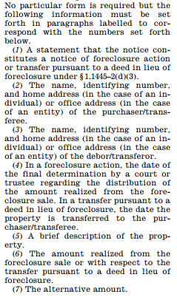
Alternative Amount Notice Requirements - IRS
Notice to The IRS
Minimum requirements specified in Treas. Reg. § 1.1445-2(d)(3)(iii)
Seven detailed sub-paragraphs
Identifying the notice
Information about the transferee
Information about the transferor
Distribution of proceeds
Information about the property, amount realized, and alternative amount.

Slide 59
Alternative Amount Notice Requirements - Court
On the day property is transferred buyer must provide notice to the court.
Treas. Reg. § 1.1445-2(d)(3)(ii)
Election to use special rules
Information about transferee
Information about the property
Date of transfer, amount realized and amount withheld
See e.g. Florida Real Property Litigation § 5.47 (2013); 1 Tex. Prac. Guide Real Estate Litigation § 4:242(F) (2014)

Slide 60
Alternative Amount Special Rule for Lenders
No notice to IRS is required if:
Buyer is the foreclosing lender
Lender required to file form 1099-A
Alternative amount is zero.
1099-A is deemed to satisfy notice requirements to the IRS
Still required to provide notice to court

Slide 61
Analysis of HARPTA Withholding Rules in Foreclosure Sales
Exemptions Buyer Can Rely Upon in Hawaii Foreclosure Sales
Transferor provides Form N-289 and one of the following apply:
Transferor’s Certification of Hawaii Resident Status
Property was transferor’s principal residence and amount realized was $300,000 or less
Entitled to Nonrecognition Treatment under law or treaty
HRS § 235-68

Slide 62
Analysis of HARPTA Withholding Rules in Foreclosure Sales
Exemptions Buyer Can Rely Upon in Hawaii Foreclosure Sales
Transferor provides Form N-289 and one of the following apply:
Transferor’s Certification of Hawaii Resident Status
Property was transferor’s principal residence and amount realized was $300,000 or less
Entitled to Nonrecognition Treatment under law or treaty
No. Requires cooperation by the Transferor.

Slide 63
Analysis of HARPTA Withholding Rules in Foreclosure Sales
Exemptions Buyer Can Rely Upon in Hawaii Foreclosure Sales
Other
Obtain Hawaii Withholding Certificate Form N-288B
HRS § 235-68(e)

Slide 64
Analysis of HARPTA Withholding Rules in Foreclosure Sales
Exemptions Buyer Can Rely Upon in Hawaii Foreclosure Sales
Other
Obtain Hawaii Withholding Certificate Form N-288B
Yes. Commissioner may sign form confirming “insufficient proceeds” to pay costs of sale and all liens and encumbrances.
HRS § 235-68(e)

Slide 65
Analysis of HARPTA Withholding Rules in Foreclosure Sales
Exemptions Buyer Can Rely Upon in Hawaii Foreclosure Sales
Other
Obtain Hawaii Withholding Certificate Form N-288B
Written Agreement with the Department of Taxation

Slide 66
Analysis of HARPTA Withholding Rules in Foreclosure Sales
Exemptions Buyer Can Rely Upon in Hawaii Foreclosure Sales
Other
Obtain Hawaii Withholding Certificate Form N-288B
Written Agreement with the Department of Taxation
Possibly. Authorized for buyers “who engage in more than one real property transaction in a calendar year” or persons for whom “withholding requirements” are not “practicable”.
HRS § 235-68(g)

Slide 67
HARPTA Exemption
No withholding if:
Insufficient proceeds to pay the withholding after paying selling expenses and any mortgage or lien secured by the property
Must File Form N-288B
Due: At least 10 days prior to closing
Commissioner can execute. See Department of Taxation, Tax Facts 2010-1, pg. 5.
HRS § 235-68(e)

Slide 68
Evaluating and Defining The Risk - The Challenge
FIRPTA and HARPTA withholding issues have rarely come up in the past
Informed buyers may make this an issue
IRS may begin increased enforcement
Nobody wants to be the test case
Develop a plan to avoid surprises and mitigate risk

Slide 69
Evaluating and Defining the Risk
Issues
Foreclosing lenders could lose out on 15% of the purchase price
Buyers may be reluctant to bid
Tax liability
Uncertainty
Evaluate loan origination procedures
Evaluate loan servicing and pre-foreclosure procedures

Slide 70
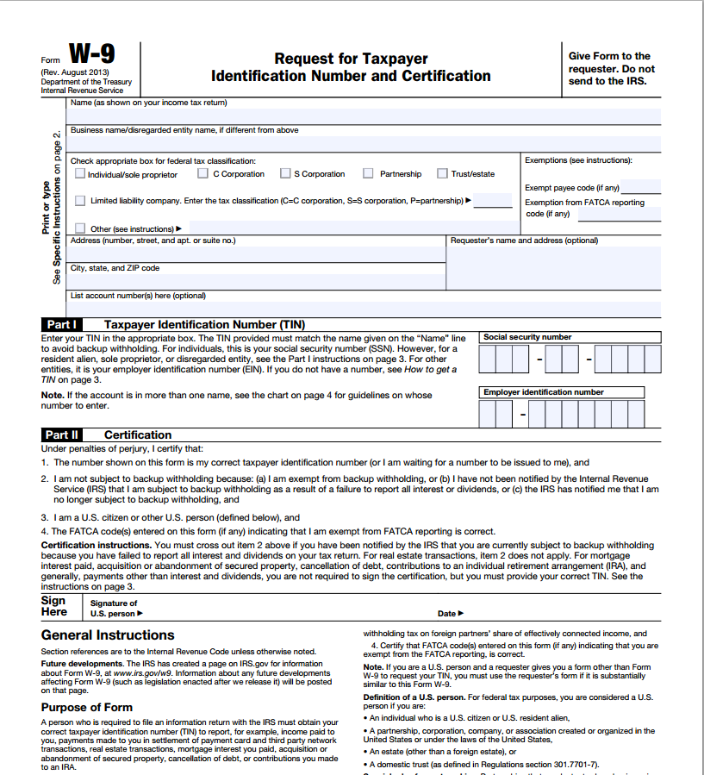
Develop a Plan
Evaluate Loan Origination Procedures
Lending to foreigners?
Obtain W-9

Slide 71
Develop a Plan
Address
Taxpayer I.D.
“Under penalty of perjury…”
“I am a U.S. citizen …”

Slide 72
Develop a Plan
Evaluate Loan Origination Procedures
Preserve the W-9 in the loan file

Slide 73
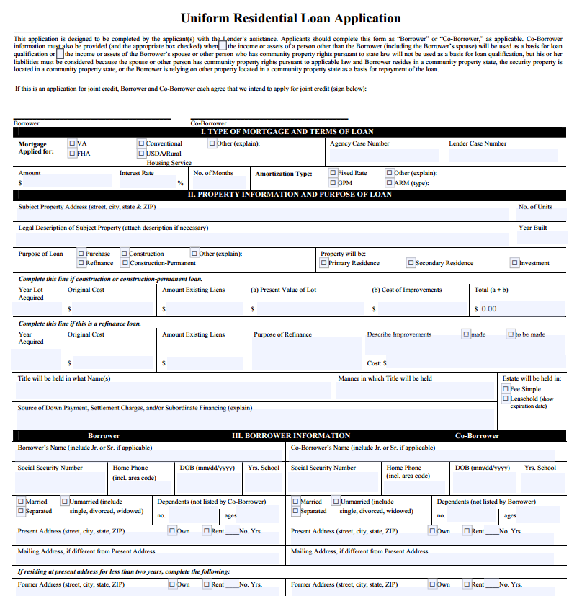
Develop a Plan
Evaluate Loan Origination Procedures
Is other documentation suitable?
Uniform Residential Loan Application

Slide 74
Develop a Plan
Social Security Number
Address

Slide 75
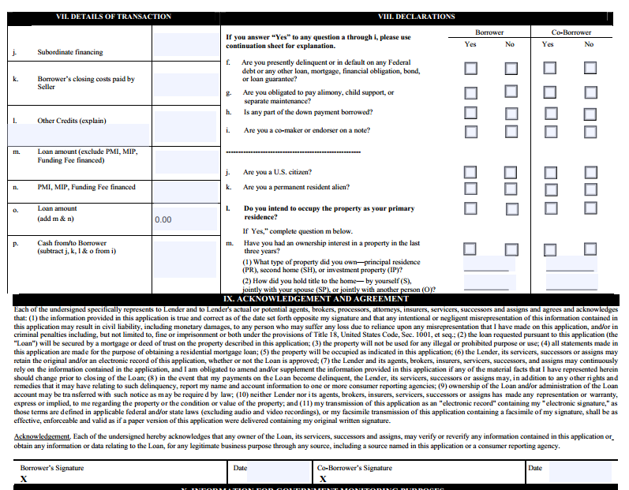
Develop a Plan
“Declarations”
“Are you a U.S. Citizen”
Signed under penalty of 18 U.S.C. § 1001

Slide 76
Develop a Plan
Evaluate Loan Origination Procedures
Is other documentation suitable?
Uniform Residential Loan Application
Close, but not a good substitute.

Slide 77
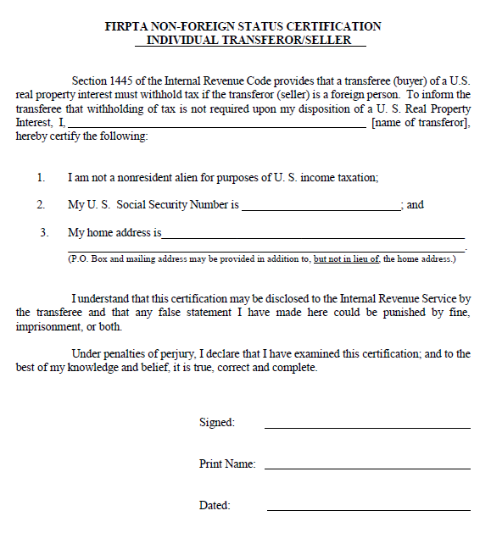
Develop a Plan
Evaluate Loan Origination Procedures
Is other documentation suitable?
FIRPTA Specific Documentation
Certification of Non Foreign Status

Slide 78
Develop a Plan
Evaluate Loan Origination Procedures
Is other documentation suitable?
FIRPTA Specific Documentation
Certification of Non-Foreign Status
Reference Section 1445 of the Internal Revenue Code
Not a non-resident alien
Address
Taxpayer I.D. Number
Signed under penalty of perjury

Slide 79
Develop a Plan
Evaluate Loan Servicing Procedures
Request new W-9 or FIRPTA Certification at regular intervals
Confirm existence of W-9/FIRPTA Certification when loan sold or transferred

Slide 80
Develop a Plan
Evaluate Pre-Foreclosure Procedures
Confirm existence of FIRPTA Certification or W-9 before filing suit
If no certification or form can be located, evaluate options
Accept that % of foreclosure proceeds will be withheld
Anticipate and develop credit bid strategy
Anticipate use of “alternative amount”(FIRPTA) and “insufficient proceeds” (HARPTA) exceptions
Modify conditions of sale.

Slide 81
Develop a Plan
Foreclosure Proceedings
Revise pleadings:
Request express authority to provide highest bidder with Defendants’ form W-9.
Make acceptance of the W-9 a condition of the sale.

Slide 82
Develop a Plan
Foreclosure Proceedings
Revise pleadings:
If proceeds are less than the amounts owed have Court make an express finding that
the alternative amount under Tres. Reg. §1.1445-2(d)(3)(i)(A) shall be deemed to be zero.
there are insufficient proceeds to pay the withholding under HRS § 235-68(b) after payment of all costs, including selling expenses and the amount of any mortgage or lien secured by the property.
Authorize and direct Commissioner to complete Form N-288B

Slide 83
Develop a Plan
Foreclosure Proceedings
Revise pleadings:
Notice of sale should clearly state any conditions pertaining to FIRPTA/HARPTA withholding
If conditions are too onerous, you may reduce the pool of potential buyers.

Slide 84
Develop a Plan
Foreclosure Proceedings
Additional documentation requirements
HARPTA
Commissioner executes Form N-288B.
Must submit Form N-288B to, and obtain approval from, State Department of Taxation at least 10 days prior to closing.

Slide 85
Develop a Plan
Foreclosure Proceedings
Additional documentation requirements
FIRPTA
On the day of purchase, buyer must notify Court that buyer is using the special rules applicable to foreclosures.
Provide other details about sale.
Treas. Reg. § 1.1445-2(d)(3)(ii)

Slide 86
Develop a Plan
Foreclosure Proceedings
Additional documentation requirements
FIRPTA
20 Days after the Order Granting the Motion to Confirm Sale, buyer must provide a “Notice of Foreclosure” to the IRS.
Provide information about parties and sale.
Treas. Reg. § 1.1445-2(d)(3)(iii)

Slide 87
Questions

Slide 88
Neither the speaker nor Ashford & Wriston is rendering any legal opinions in this presentation (including any written material). This presentation is provided for general information only. The reader should consult an attorney before applying the information to a specific situation.

